Slide 1
Innovative practices for WRM in Portugal
Rodrigo Proença de Oliveira
Department of Civil Engineering, Architecture and Georesources
Instituto Superior Técnico, Universidade de Lisboa, Portugal
Vienna, 9th May 2019

Slide 2
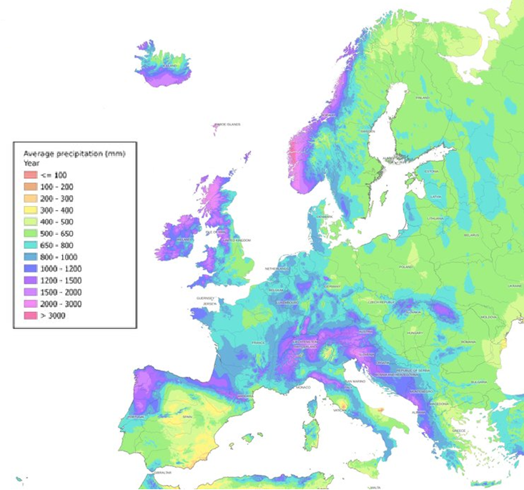
Portugal’s main water management challenges
Water scarcity and meteorological variability
Adaptation to climate change impacts
Transboundary water management
Surface and groundwater integrated management
Control of non-point source pollution and hydro morphological pressures to improve water bodies good status

Slide 3
Water scarcity and meteorological variability

Slide 4
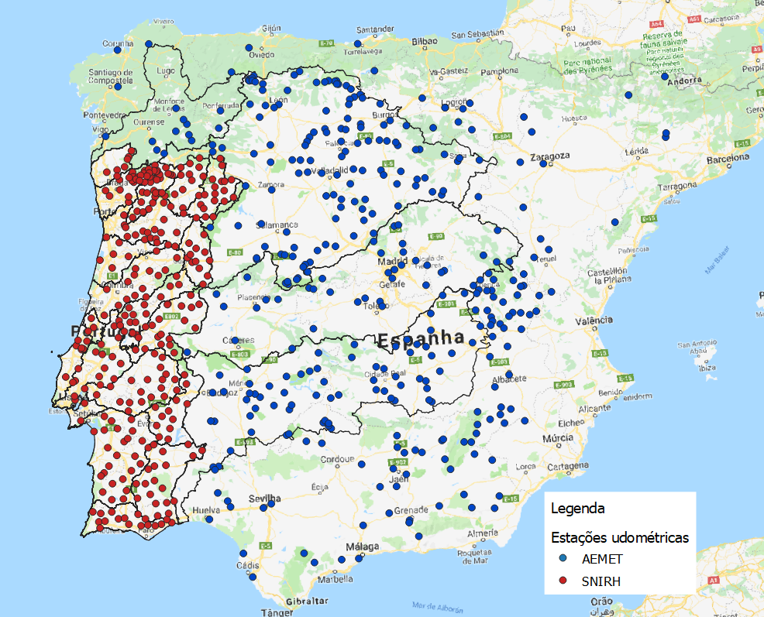
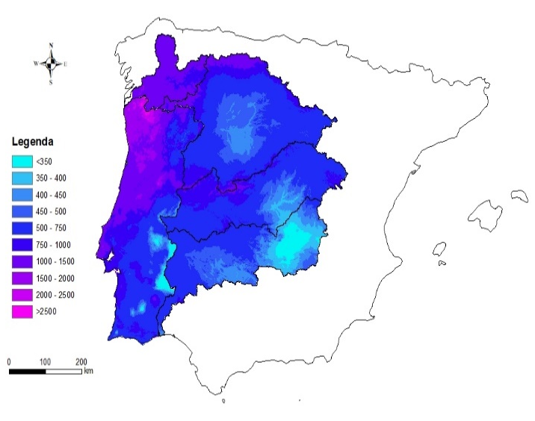
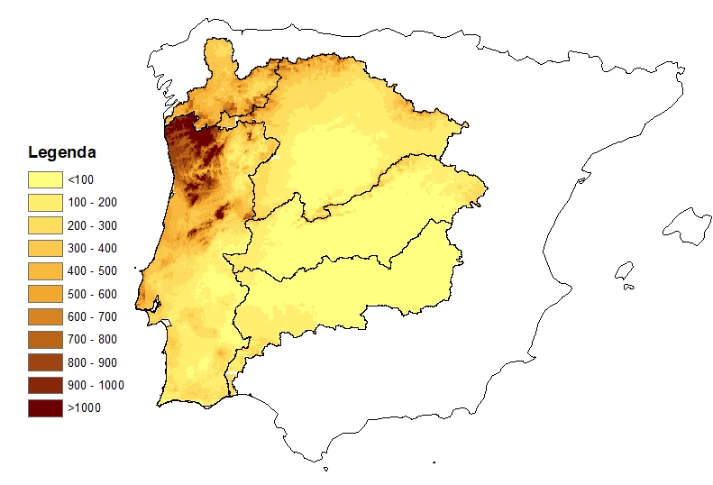
Large scale hydrological modeling
Rainfall monitoring
Annual average precipitation
Annual average runoff

Slide 5
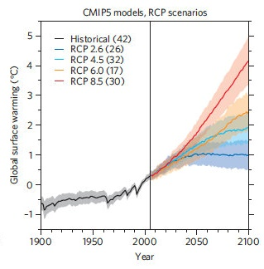
Climate change projections
Socio-economic scenarios
Emissions scenarios
Global circulation models
Regional circulation models
Sector
models
Notes:
Portal do Clima – 9 modelos regionais
EU-CORDEX – 40 modelos regionais
Lista em http://euro-cordex.net/imperia/md/content/csc/cordex/20161219-eurocordex-simulations.pdf

Slide 6
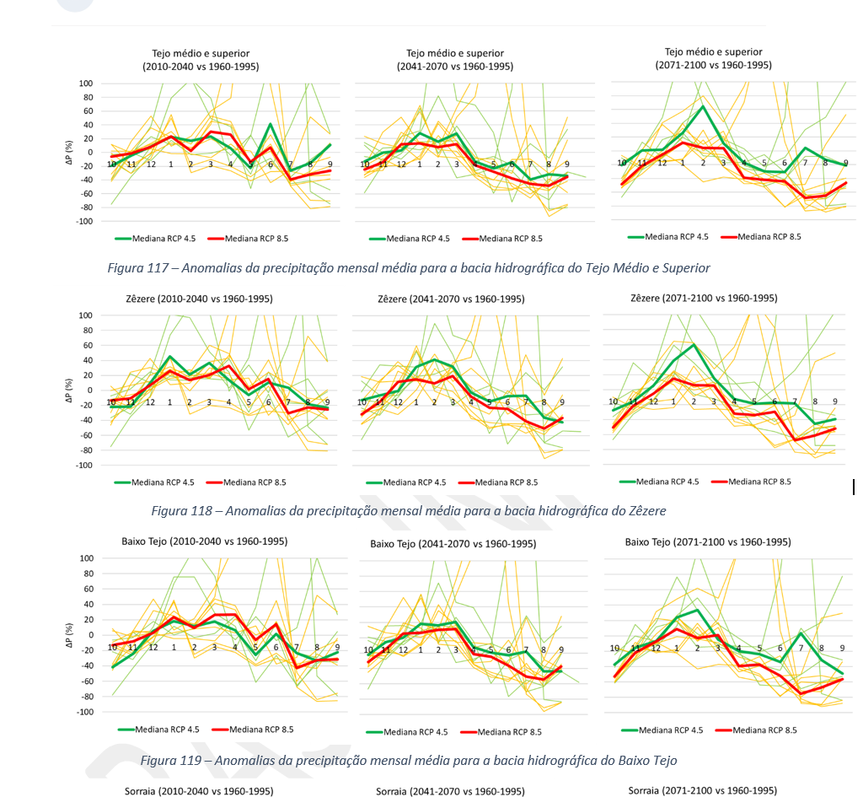
Regional climate scenarios for Portugal and Spain

Slide 7
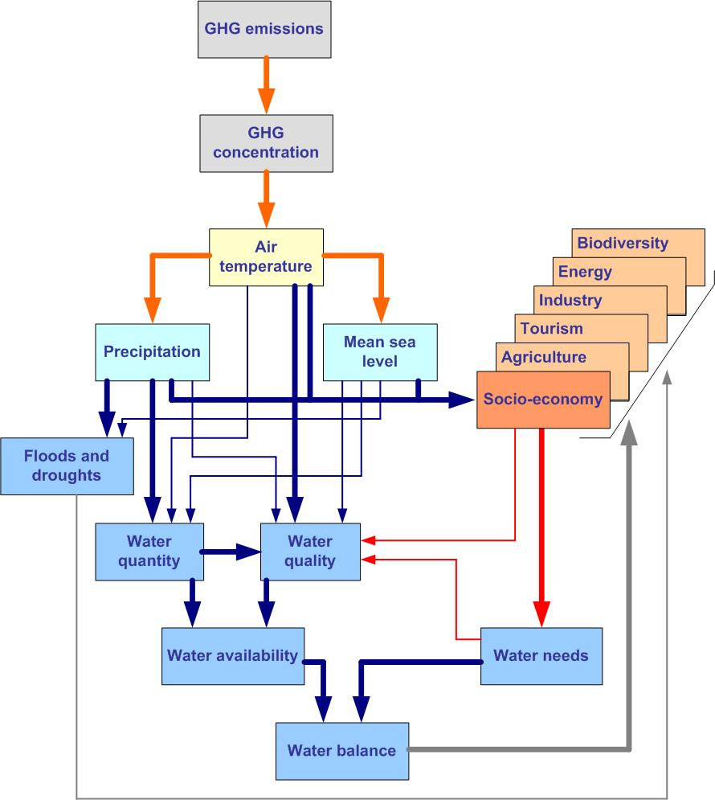
Climate change impacts on water resources
Issue | Impacts in Portugal
Water availability | Decrease of annual runoff and aquifer recharge, mainly in the South. Increase of flow variability and of the regional asymmetry of water availability. Increase of drought risk.
Water demand | Possible increase of water demand for agriculture. Increase of water demand for energy production to reduce dependence on fossil fuels;
Water quality | Decrease of water quality due to flow reduction, temperature increase and possible soil erosion increase. Salinization of coastal aquifers due to mean sea level rise and recharge decrease. Degradation of ecosystems health.
Flood Risk | Increase of flood risk, mainly in the North and in coastal areas
Notes:
We all know that water is the sector most affected by climate change, which has direct and indirect impacts on water resources. Climate change affects water quantity (availability, timing and variability) and water quality, water supply and water demand. This figure tries to illustrate all these relationships, direct and indirect, with the stronger relationships shown in thicker lines.
Southern Europe, and particularly Portugal, is expected to be one of the most affected regions in Europe. The table presents the main expected impacts.

Slide 8
Planning adaptation to climate change impacts
Main goal: Reduce vulnerability
Decision-making under uncertainty
Bridging the gap between policy sectors and government levels
Bridging national boundaries: transboundary water management
Mainstreaming adaptation
Managing risk and uncertainty for resilience and disaster preparedness
Notes:
Our main goal is to reduce the vulnerabilty of our systems. The vulnerabilty of a system is a function of:
Its sensitivity (or robustness, which is the complement of sensitivity);
The system exposure to external pressures – in our case it is the climate
And its resilience, ie its capacity to recover from unsatisfactory conditions
We can act on these three areas.

Slide 9
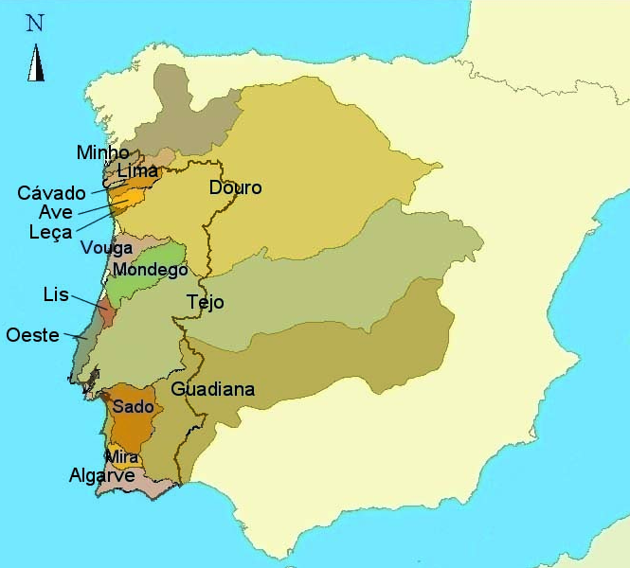
Transboundary water management
Portuguese main rivers have its source in Spain;
These river basins cover 65% of Portugal and around 70% of these river basins are in Spain;
There are minimum flow requirements and water quality issues;
A joint agreement supports their management.
 | A (km2) Portugal | A (km2) Spain | A (km2) Total
Minho | 850 | 16.230 | 17.080
Lima | 1.180 | 1.300 | 2.480
Douro | 18.600 | 79.000 | 97.600
Tejo | 24.800 | 55.800 | 80.600
Guadiana | 11.500 | 55.300 | 66.800

Slide 10
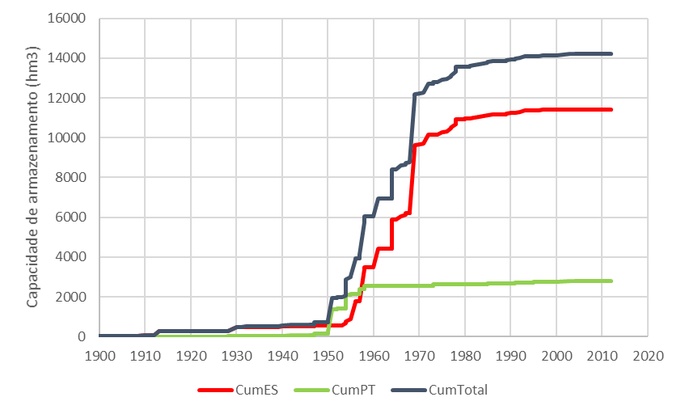
Tagus river basin: Storage capacity increase
Tejo-Segura 1979 (max 650 hm³/ano)
Tejo
Alcântara 1969 (3160 hm³)
Espanha
Valdecañas 1964 (1446 hm³)
Gabriel y Galan 1961 (911 hm³)
Buendia 1958 (1639 hm³)
Entrepeñas 1956 (835 hm³)
Cabril 1954 (719 hm³)
Portugal
Castelo de Bode 1951 (1100 hm³)

Slide 11
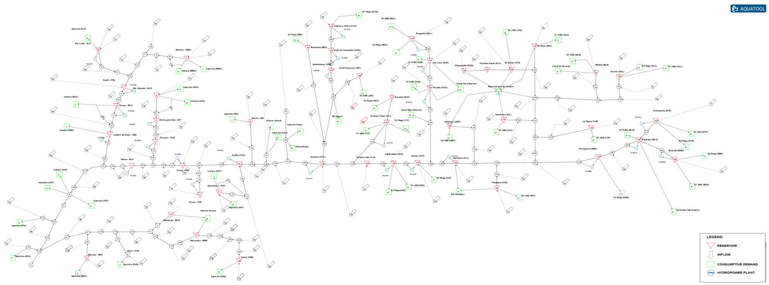
Tagus river basin simulation
A network of 160 nodes covering both Portugal and Spain
(97 inflow nodes; 58 demand nodes; 48 reservoirs and 27 hydropower plants)
Estimate demand satisfaction reliability under several future scenarios of socio-economic and climate change;
Optimize river basin management.

Slide 12
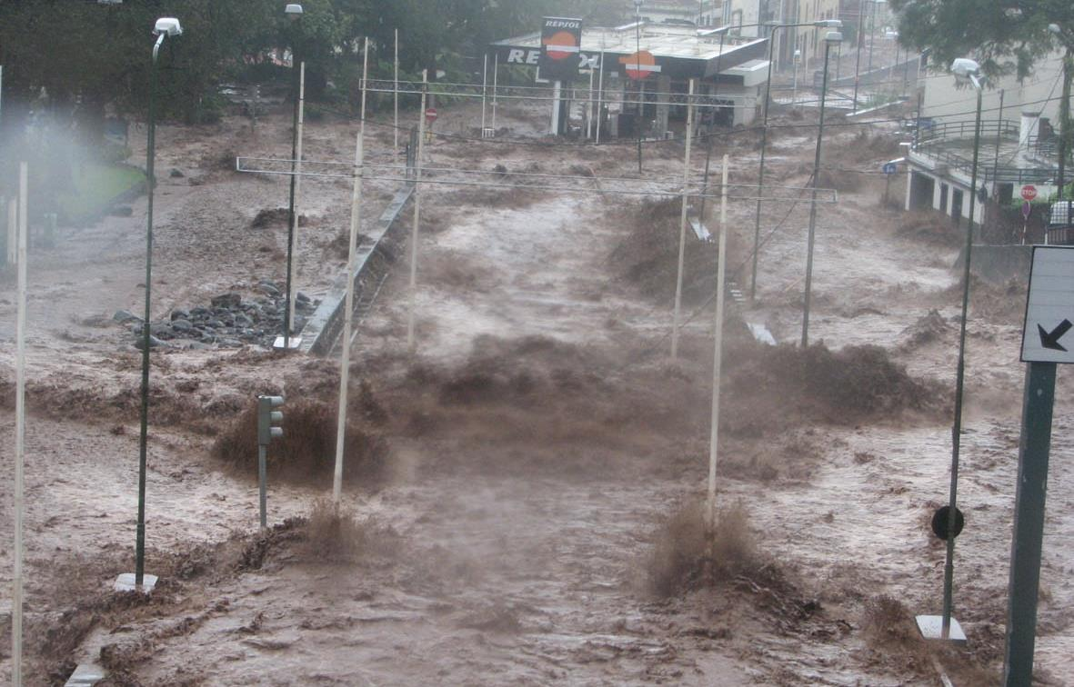
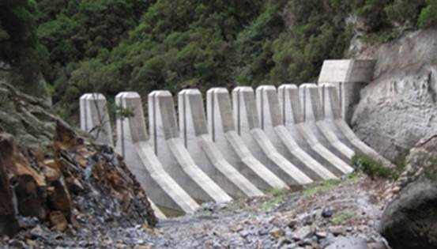
Other projects
Assessment of landslides and debris flow risks
Citizen science: Curating social media data for flood forecasting
Projects around the world
Water sharing agreements within the São Francisco River Basin, Brazil
Simulation of streamflow, sediment and contaminant loads using SWAT, Brazil
Water Resources Assessment, Angola
Maputo Urban Drainage Plan, Mozambique

Slide 13
Innovative practices for WRM in Portugal
Luís Ribeiro
Department of Civil Engineering, Architecture and Georesources
Instituto Superior Técnico, Universidade de Lisboa, Portugal
Vienna, 9th May 2019

Slide 14
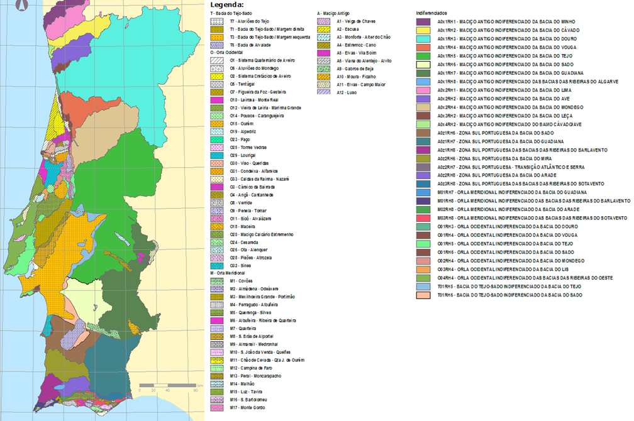
GROUNDWATER BODIES

Slide 15
INNOVATIVE METHODOLOGIES
Identification of Vulnerable Zones
Assessment of Trend Analysis for Increasing the Concentration of Pollutants in the Groundwater Bodies and the Reverse of the Trend
Identification of Groundwater Dependent Ecosystems

Slide 16
INNOVATIVE METHODOLOGIES
Identification of Vulnerable Zones
Assessment of Trend Analysis for Increasing the Concentration of Pollutants in the Groundwater Bodies and the Reverse of the Trend
Identification of Groundwater Dependent Ecosystems

Slide 17
Nitrates Directive
This Directive aims to reduce water pollution caused or induced by nitrates from agricultural sources and prevent the spread of pollution in bodies of water.
Identify polluted and susceptible waters
Develop action plans for vulnerable areas
Monitor the effectiveness of the implementation of action plans for vulnerable areas.

Slide 18
Vulnerable areas
Vulnerable areas are the areas that drain into polluted or nitrate-polluted waters and where there are agricultural activities that can contribute to pollution. For the identification of polluted waters and water at risk of being contaminated by nitrates of agricultural origin

Slide 19
METHODOLOGY
In Portugal the methodology for assessing groundwater chemical status consisted of the application of the following procedure:
comparison of mean values of Susceptibility Index, quantification of diffuse pressures and risk of contamination in the recharge area in order to assess vulnerability to contamination;

Slide 20
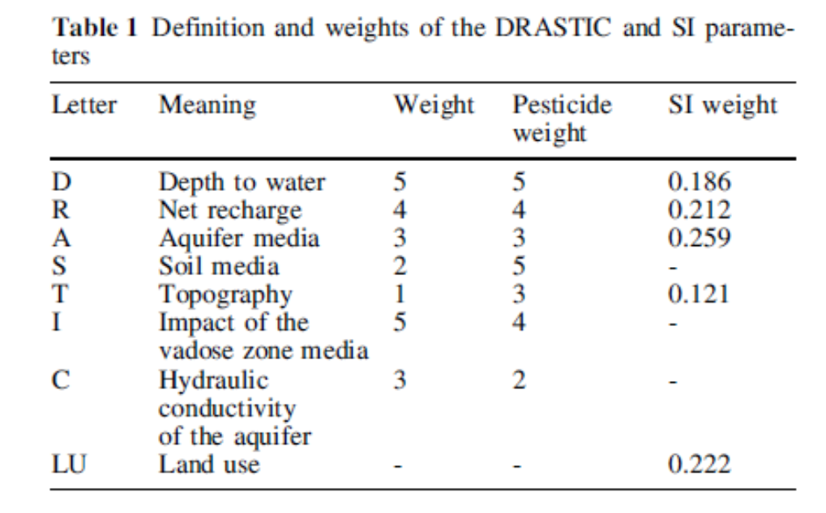
SUSCEPTIBILITY INDEX
The Susceptibility Index (SI), an adaptation of the DRASTIC method, was developed with the intention of evaluating aquifer vulnerability with respect to diffuse agricultural pollution in hydrogeological settings typically found in Portugal. The main difference is the addition of a parameter defining land cover, thus abandoning the concept of a purely intrinsic vulnerability assessment method.

Slide 23
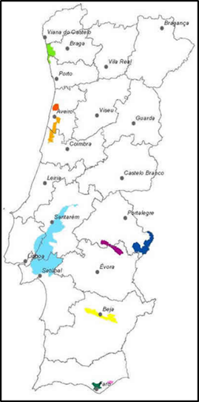

Slide 24
3 INNOVATIVE METHODOLOGIES
Identification of Vulnerable Zones
Assessment of Trend Analysis for Increasing the Concentration of Pollutants in the Groundwater Bodies and the Reverse of the Trend
Identification of Groundwater Dependent Ecosystems

Slide 25
The methodology used in Portugal to assess the trend analysis evaluates the following behaviors of the time series:
• Time trend of the series: in this case, the methodology should detect the statistical significance of a downward or upward trend of values over time and their range of change;
• Trend reversal: the methodology should detect the occurrence of a reversal of a trend and mark the date on which this reversal occurred;
• Correction of seasonality

Slide 26
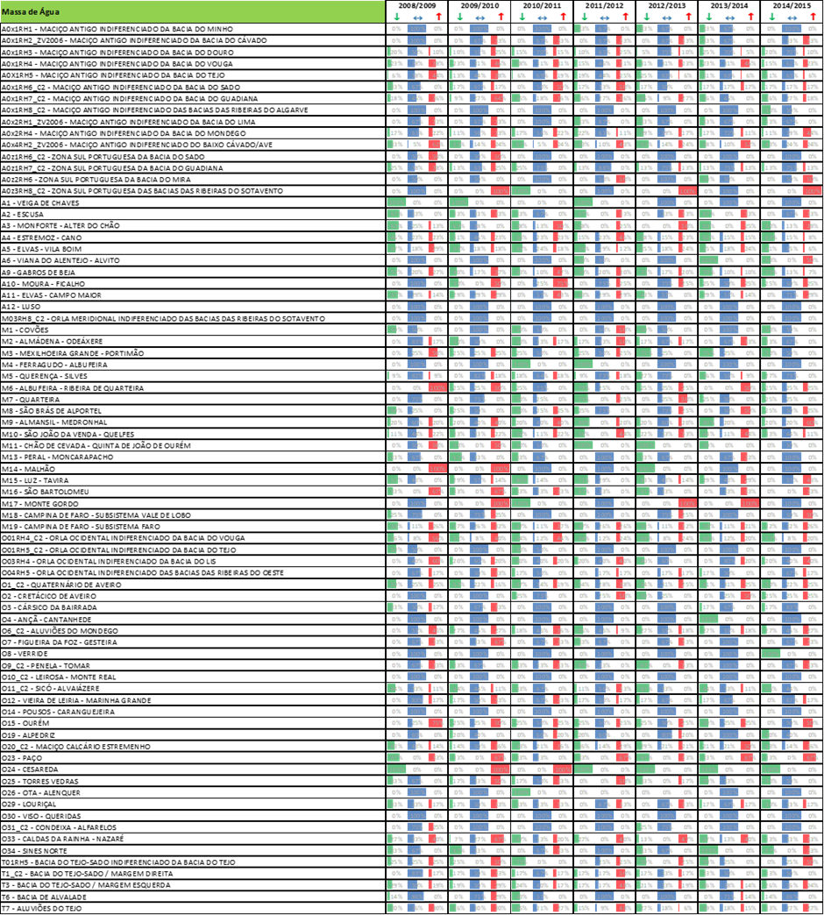
Mann Kendall with seasonal correction and Theil-Sen slope calculation
LOWESS (Locally Weighted Scatterplot Smoothing) operator
Singular Spectrum Analysis

Slide 27
3 INNOVATIVE METHODOLOGIES
Identification of Vulnerable Zones
Assessment of Trend Analysis for Increasing the Concentration of Pollutants in the Groundwater Bodies and the Reverse of the Trend
Identification of Groundwater Dependent Ecosystems

Slide 28
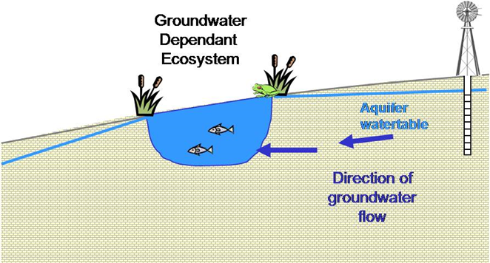
Methodology for the Identification of Groundwater Dependent Terrestrial Ecosystems

Slide 29
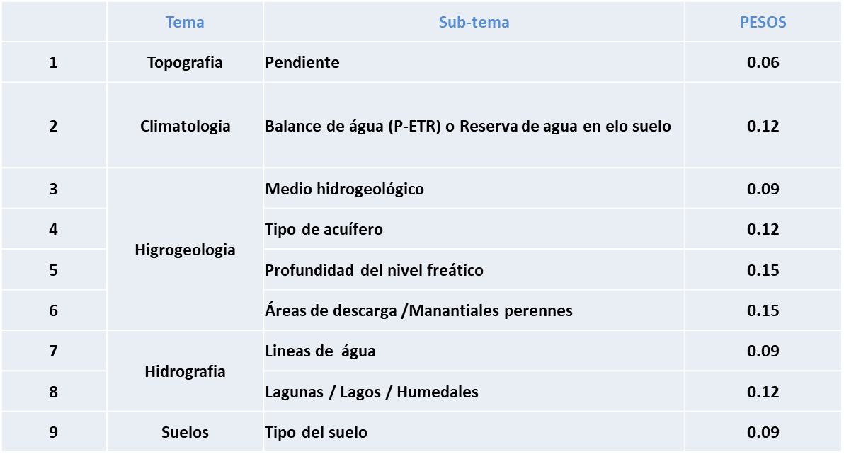
CLIMATE, HYDROLOGICAL AND HYDROGEOLOGICAL CRITERIA

Slide 30
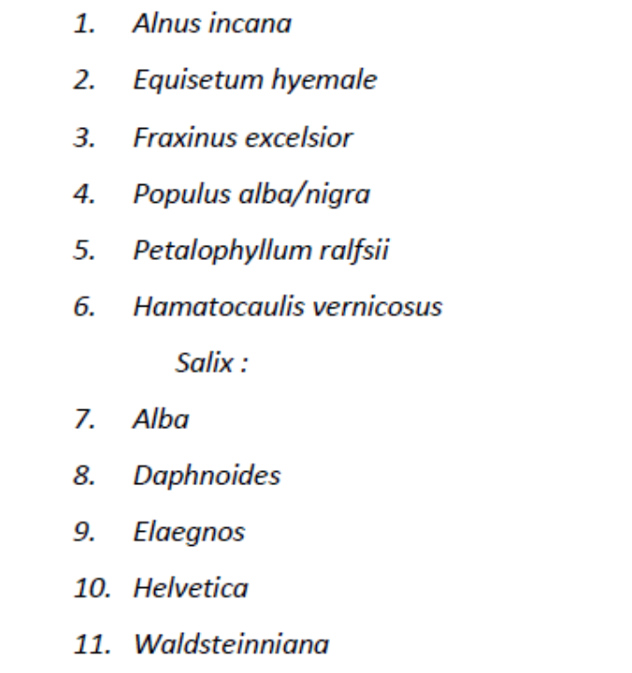
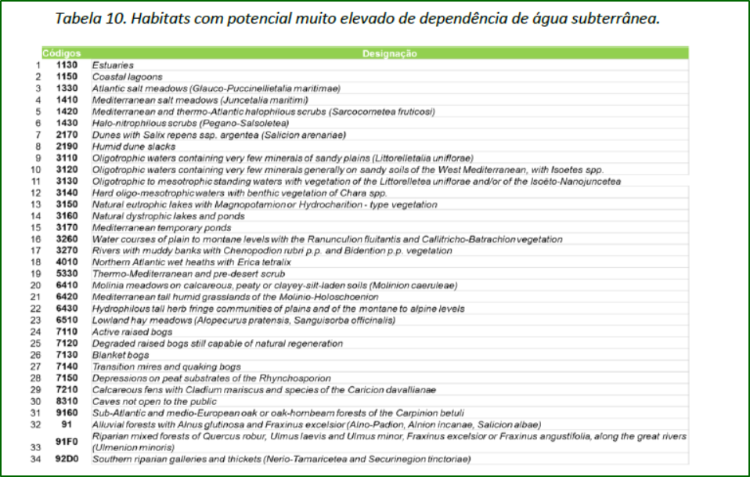
ECOLOGICAL CRITERIA
FLORA
HABITATS

Slide 31
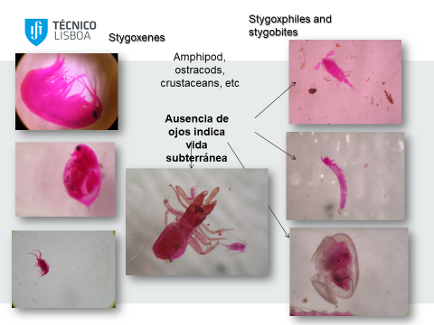
STYGOFAUNA

Slide 32
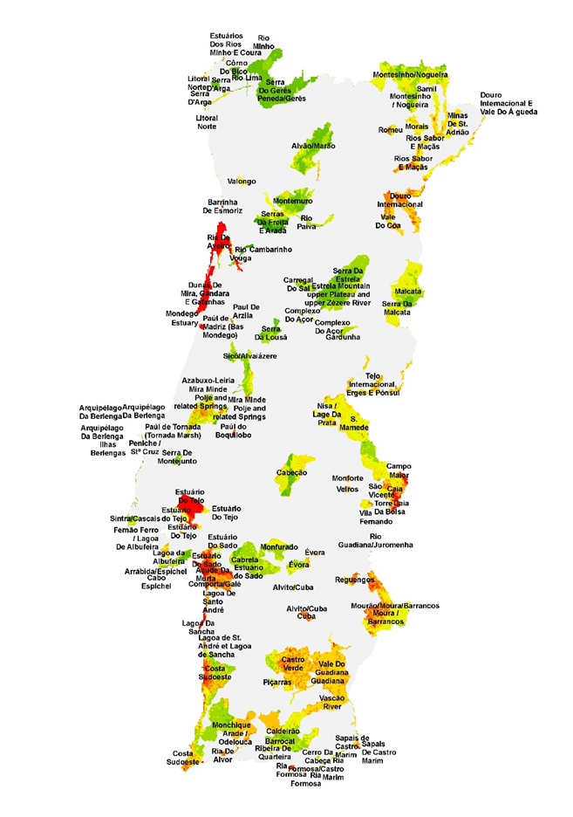

Slide 33
OTHER PROJECTS
2006-2009 - CAMINAR: Catchment Management and Mining Impacts in Arid and Semi-arid South America (Project FP6-2004-INCO-DEV-3) PERU, BOLIVIA CHILE
2010–2014 ADMICCO - Promoting the adaptation and mitigation of climate change in coastal areas reduces the vulnerability of the population with fewer resources (Project - DCIENV-2010/222-639) PERU, ECUADOR, CHILE
2016-2019 SOILTAKECARE Improved management and rehabilitation of contaminated soils in the southwestern region of Europe - Spain, Portugal and South of France. Project co-financed by the European Regional Development INTERREG SUDOE
2008-2010 CLIMWAT- Assessing And Managing The Impact Of Climate Change On Coastal Groundwater Ecosystems MORROCO, SPAIN funded by CIRCLE EU -

Slide 34
GROUNDWATCH
2014-2024 GROUNDWATCH - JOINT MASTER PROGRAMME IN GROUNDWATER AND GLOBAL CHANGE - IMPACTS AND ADAPTATION
Co-funded by the ERASMUS+ PROGRAMME OF THE EUROPEAN UNION

